Slide 1
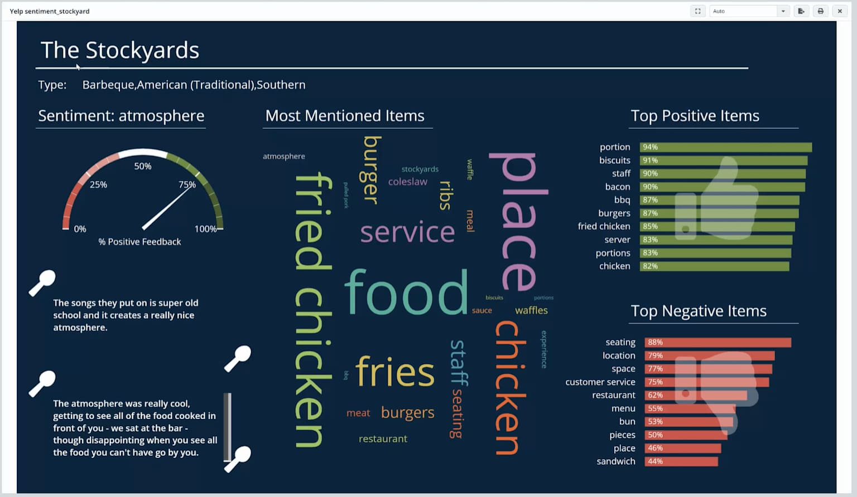
Problem Statement (E-Commerce)
Thousands of reviews across Amazon, Flipkart, Snapdeal
No unified sentiment view
Critical issues buried in text
Manual analysis takes hours
Delayed fixes → lower customer satisfaction

Slide 2
Product Review Insight Agent
AI-driven Review Analysis & Automated Action Alerts
Powered by IBM watsonx Orchestrate

Slide 3

The Solution
Automated sentiment & issue analysis
Strengths/Issues tables
Competitor comparison
Product health scoring
Automatic email alerts

Slide 4
Agent Capabilities
Reads customer reviews
Sentiment classification
Extracts strengths & issues
Computes sentiment score
Assigns risk levels
Sends Email Summary

Slide 5
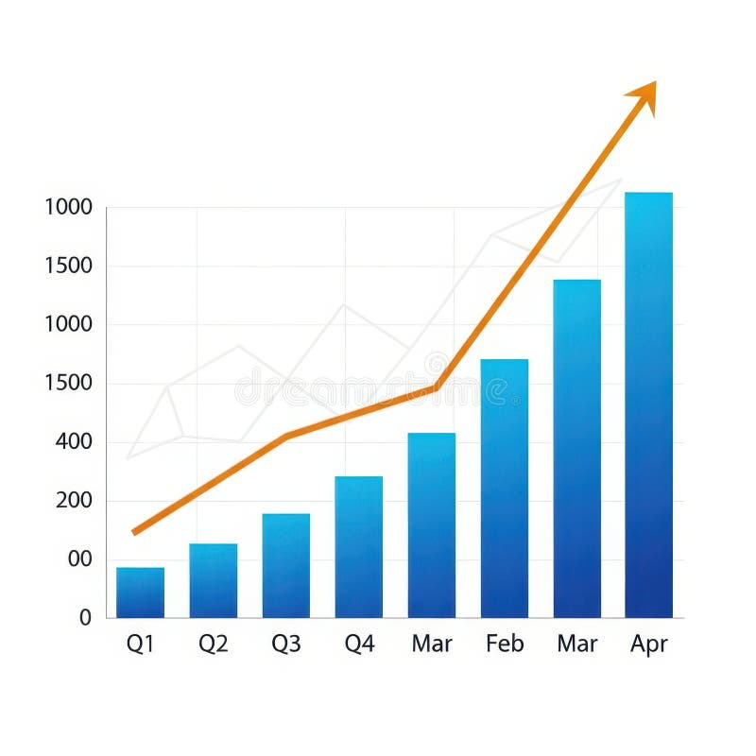
Why This Matters
Poor customer experience → high returns
Negative reviews reduce sales
Teams lack insight prioritization
Revenue & trust impacted

Slide 6
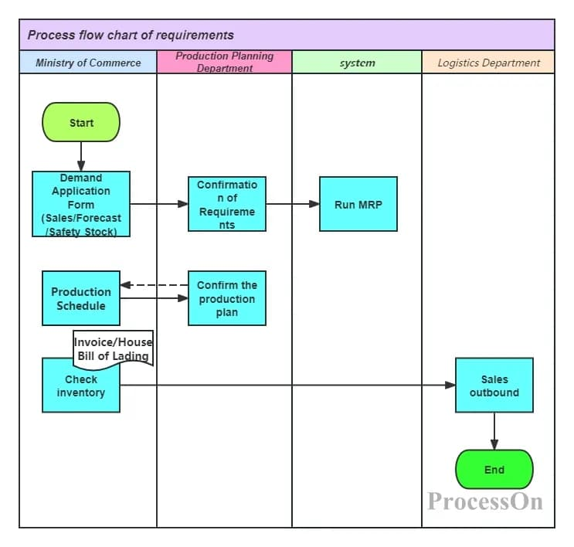
End-to-End Workflow

Slide 7
Behaviour Rules
Structured tables mandatory
Risk thresholds applied
Only provided text used
Generates Email Summary
Triggers Gmail Connector

Slide 8

Live Demo
IBM watsonx Orchestrate

Slide 9

Impact & Benefits
Hours → seconds
Zero manual effort
Traceable insights
Faster issue resolution
Automated communication

Slide 10
Thank You!
Product Review Insight Agent
Smart. Fast. Actionable.

